Slide 1
Elysium Escapes
A travel site...
By: Ileana Luts, Stefan Needham, Tyler Smalley

Slide 2
High level view
What does a travel site do?
It provides travel reviews
It provides travel fares
It provides the means for a user to book trip
It provides the user the means to find contact information for the company
It should possibly provide hotel, flight, transportation and entertainment options for destinations to inform the user of their options

Slide 3

Solution Overview

Slide 4
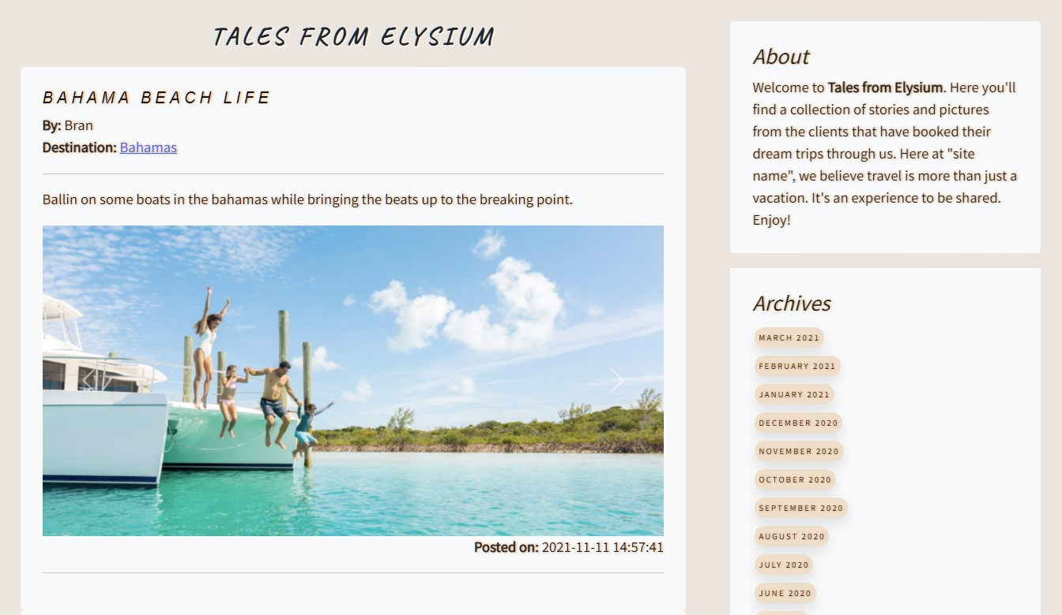
Testimonials
User can submit stories and photos of the trips that they booked through the site
Visitors can browse these stories to inform their choices

Slide 5

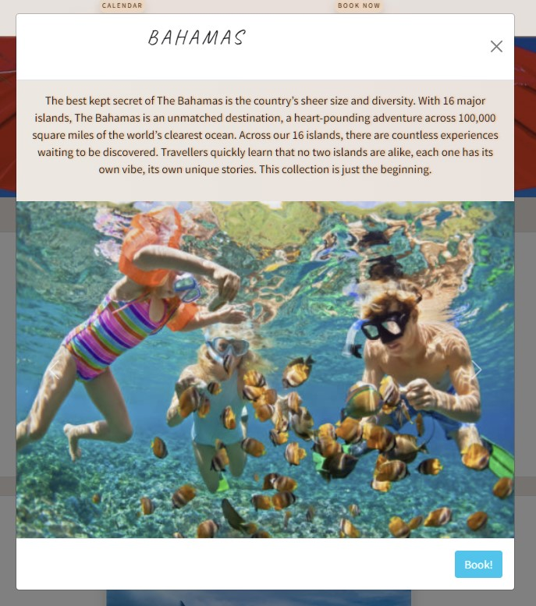
Destinations
User can browse available destinations
Each destination has a description as well as a collection of photos for the user to see
User is given the option to proceed to booking page if they’d like

Slide 6
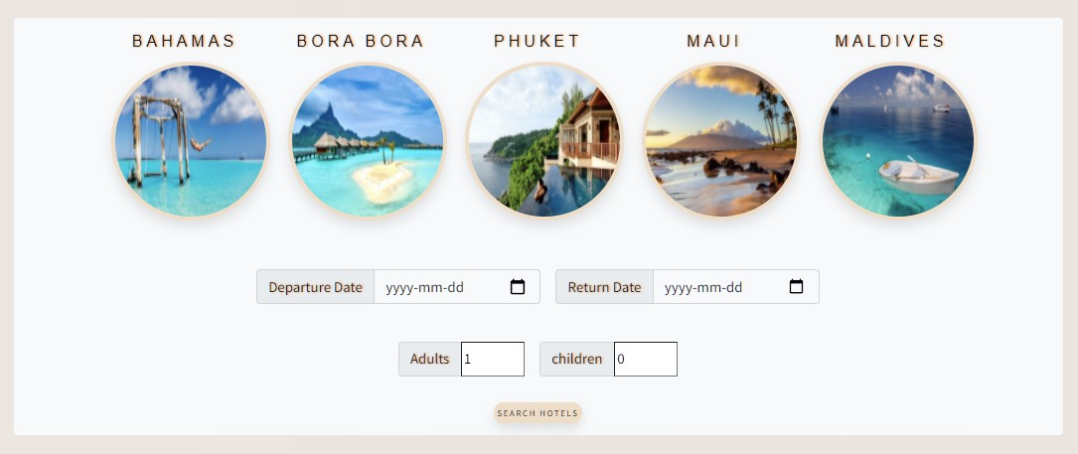
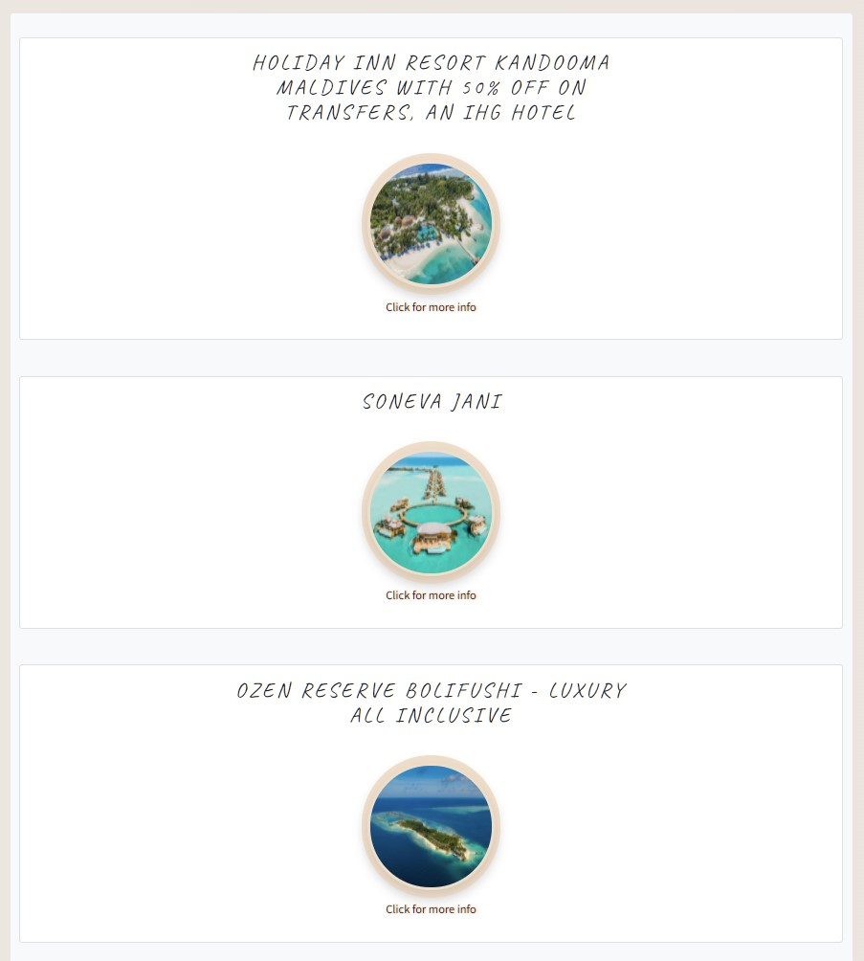
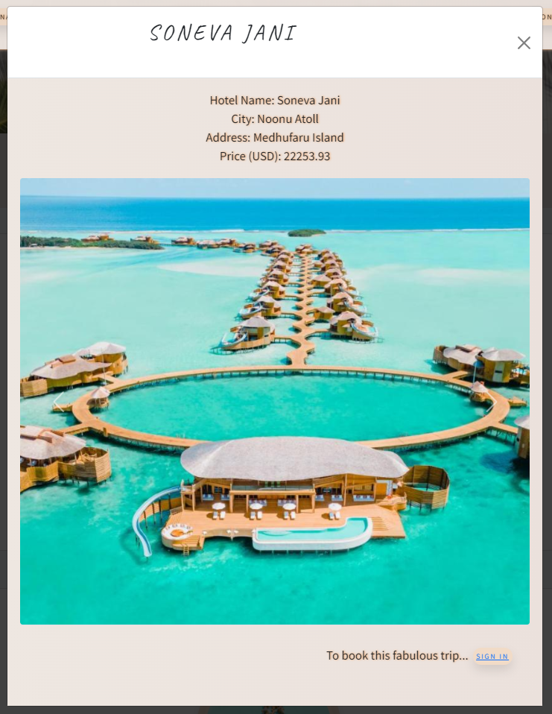
Booking
User can input desired trip details to search options
Site gives resort options according to user request
Detailed info is given on each location

Slide 7
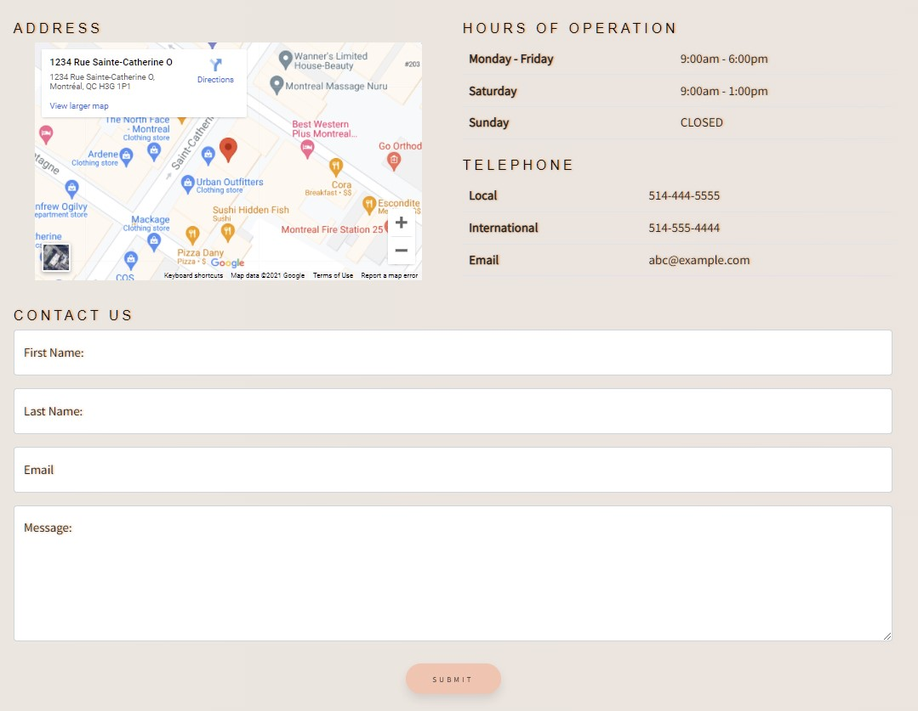
Contact Us
User can find location, hours of operation and contact info
User can leave a message

Slide 8


The User Experience
Enhanced with Bootstrap 5
Cards
Carousels
Modals
And Toast!

Slide 9
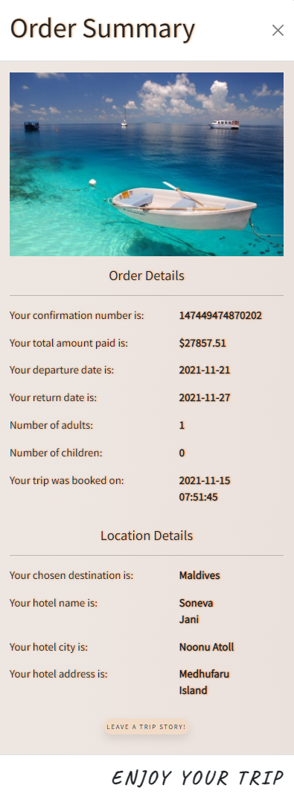
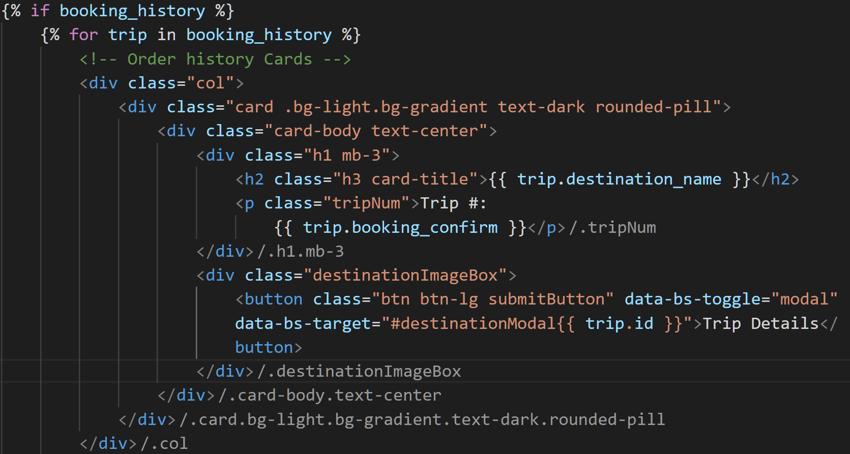
Bootstrap Cards
With lots of dynamic content, how do we organize data while giving it all a cohesive look?
Bootstrap’s cards provide a flexible and extensible content container with multiple variants and options.
This provides the benefit of displaying blocks of content that may be dynamically updated in a neat, uniform, and highly customizable way

Slide 10
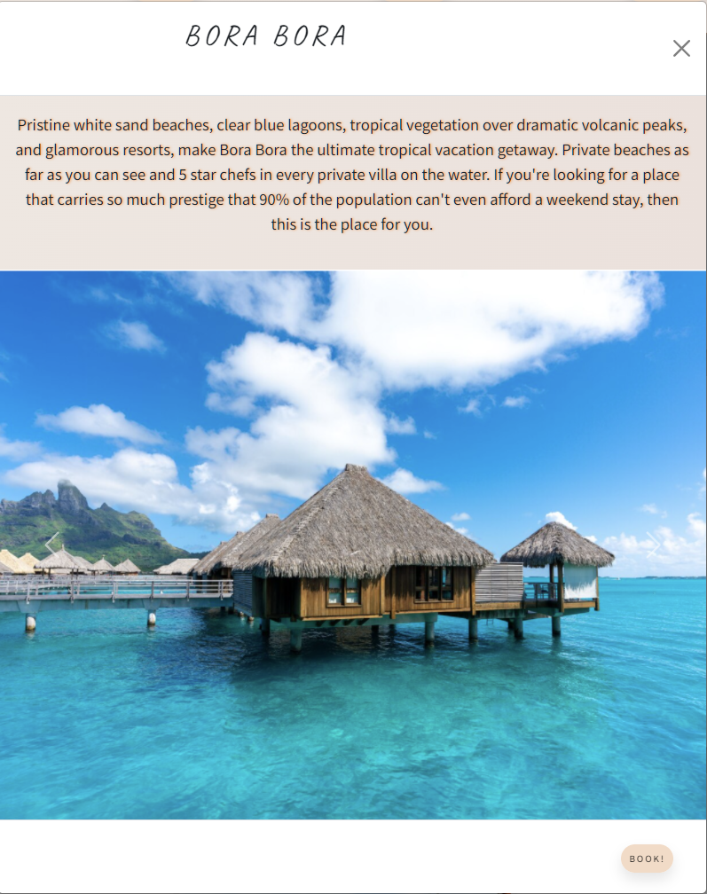
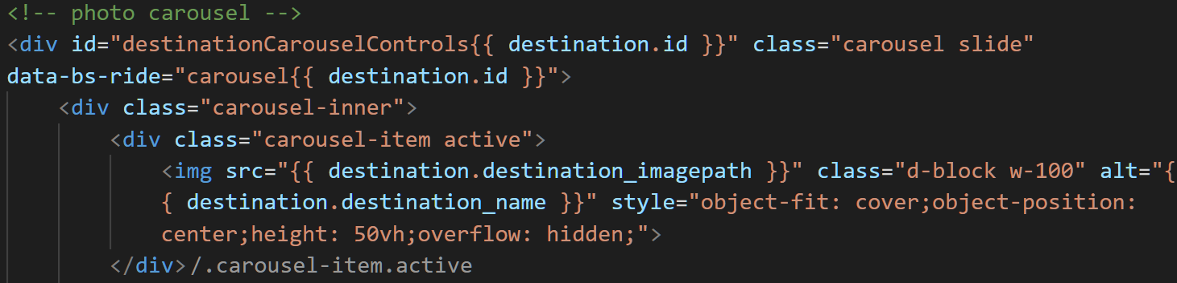
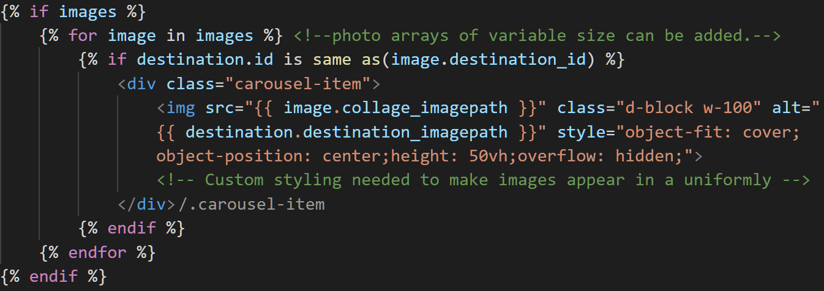
Bootstrap Carousels
How do you layout your page to display a large volume of media from dynamic sources?
The carousel is a slideshow for cycling through a series of content, built with CSS 3D transforms and a bit of JavaScript.
Bootstrap components can be combined
If prepared properly, photo arrays of variable size can be added.
*Custom styling needed to make images appear in a uniformly

Slide 11
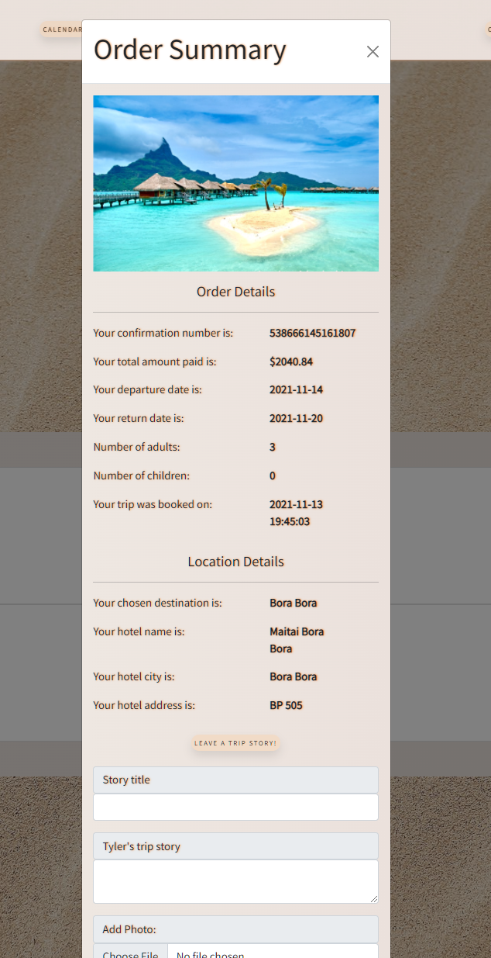
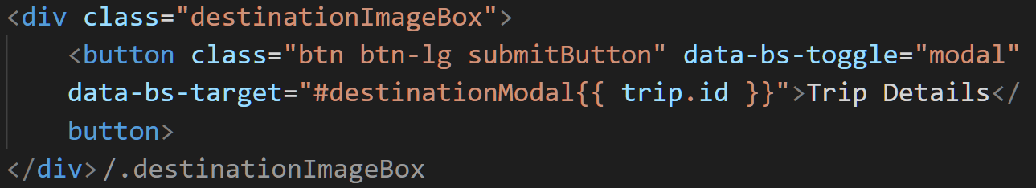
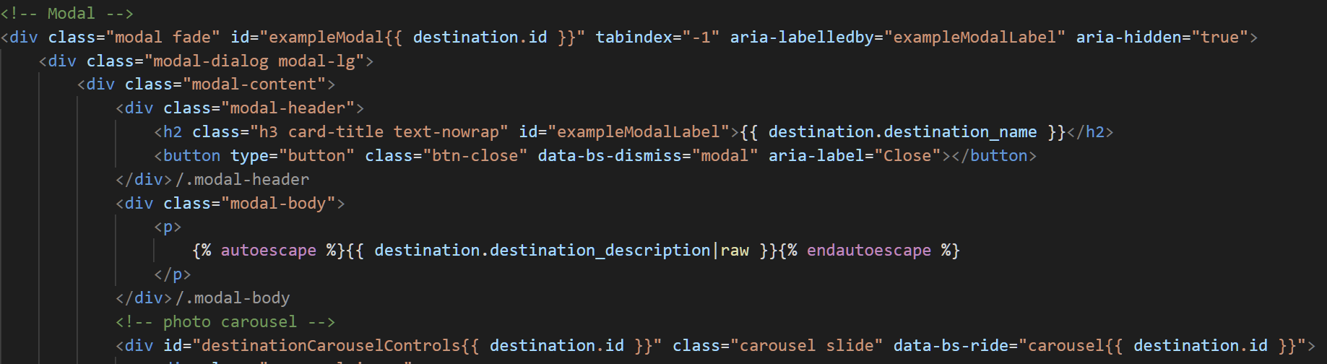
Bootstrap Modals
With lots of dynamic content, how do we keep our page neat while streamlining our directory?
Modals are built with HTML, CSS, and JavaScript. They’re positioned over everything else in the document and remove scroll from the <body> so that modal content scrolls instead
Declutters page by hiding dynamic content until called-->
Streamlines template folders
Can even hide forms inside modals!
Came with some unique problems for this site.

Slide 12
WAIT!
If modals are hidden on page reload, how do we handle form validation!?!

Slide 13
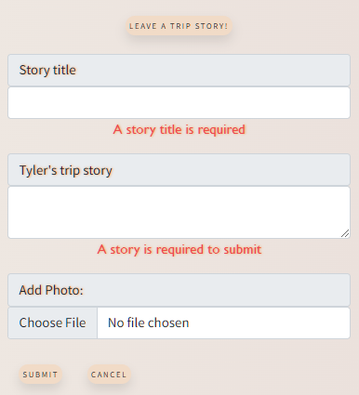
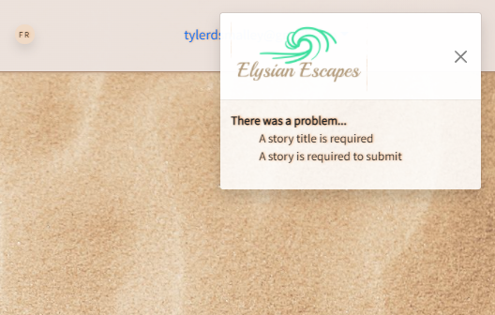
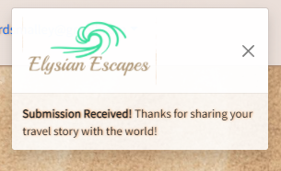
Bootstrap Toast Alerts!
Toasts are lightweight notifications designed to mimic the push notifications that have been popularized by mobile and desktop operating systems.
Toasts can be customized to overlay wherever you want on the page in absolute position so they are always seen.
Can be programmed to auto fade or stay
Must be manually called via JS

Slide 14
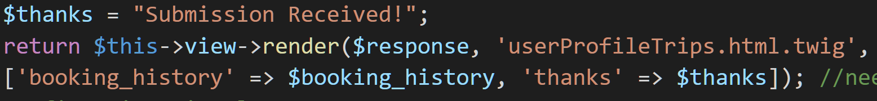
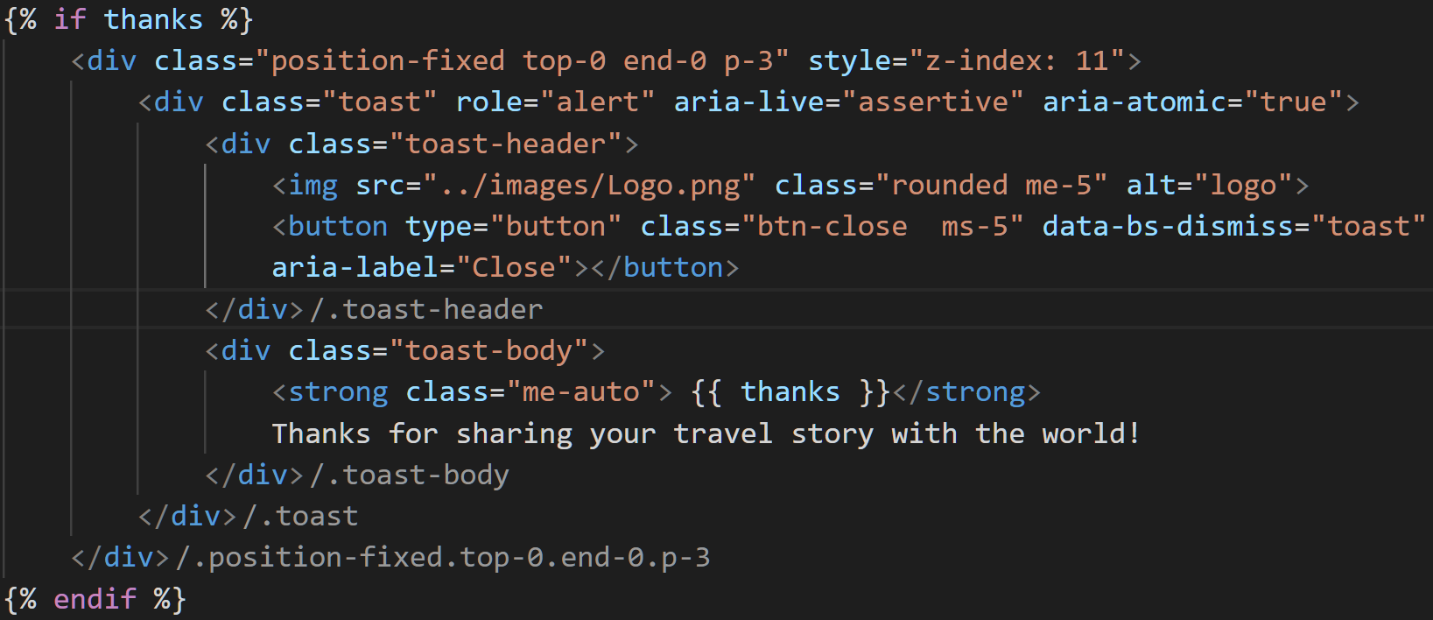
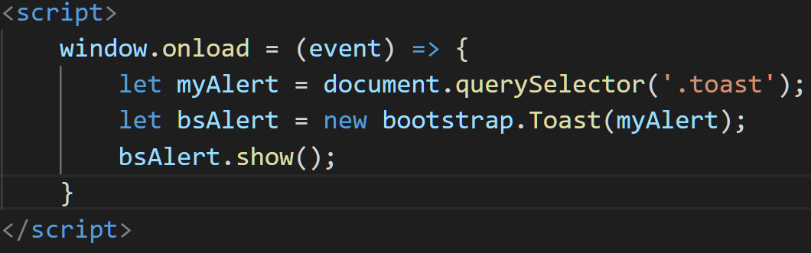
Bootstrap Toast Alerts!
Upon submission either:
insert was successful and thanks message is passed to the template
Submission failed and errors are sent to be displayed

Slide 15
Hotel Booking Data
Procured by Booking.com API

Slide 16
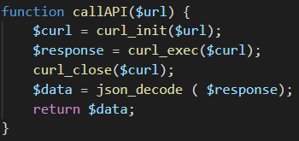
Data Procurement via Apis
https://rapidapi.com/tipsters/api/booking-com/
searchLocation($searchLocation, &$destType)
searchHotels($location, $destType, $adults, $children, $arrival, $departure)
getHotelPhotos($hotelId)
https://www.currencyconverterapi.com/
convertCurrencyToCAD($sourceCurrencyCode, $convertAmount)

Slide 17
The Payment Process
Enhanced with Stripe API

Slide 18

Stripe Payment Implementation
Challenges
Implement payment Method
Redirect to booking confirmation upon successful payment
Update payment status in DB
Solutions
Implement Stripe for payment
Use async JS to handle submission
Implement Stripe webhook to update payment status in DB

Slide 19
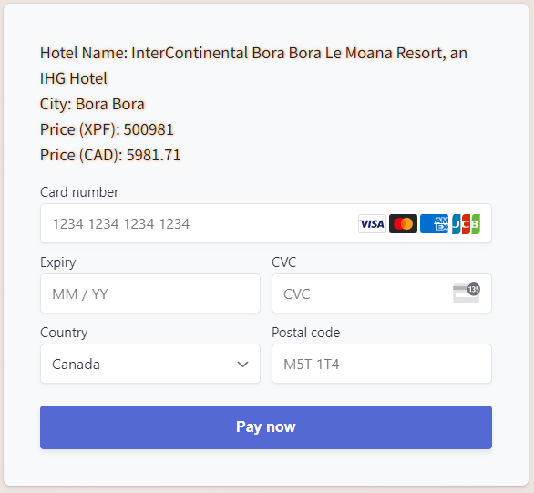
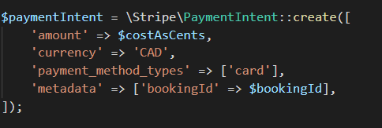
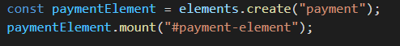
Stripe Payment Implementation (Payment Element)

Slide 20
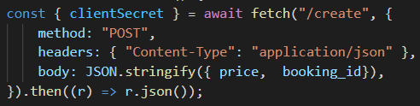
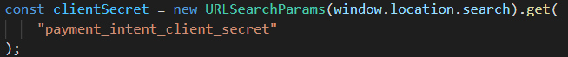
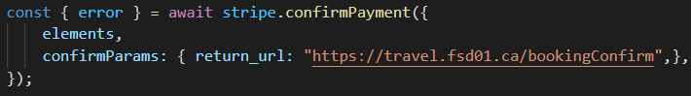
Stripe Payment Implementation (Javascript)
Create payment intent
Following form submit, await return of payment status
Redirect upon payment success

Slide 21
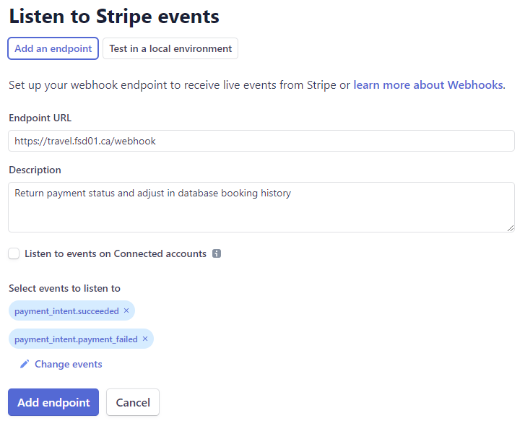
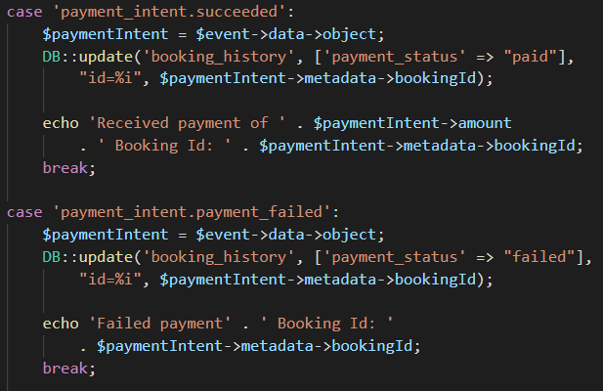
Stripe Payment Implementation (Webhook)

Slide 22
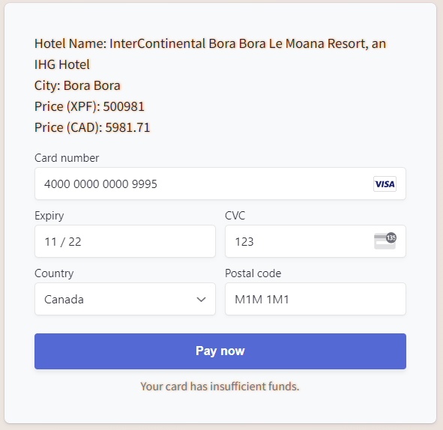
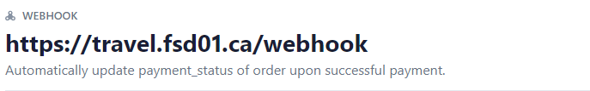
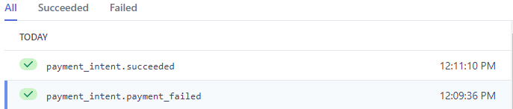
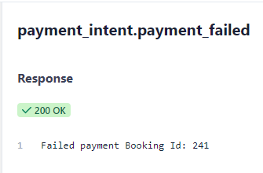
Stripe Payment Implementation (Failed Payment)

Slide 23
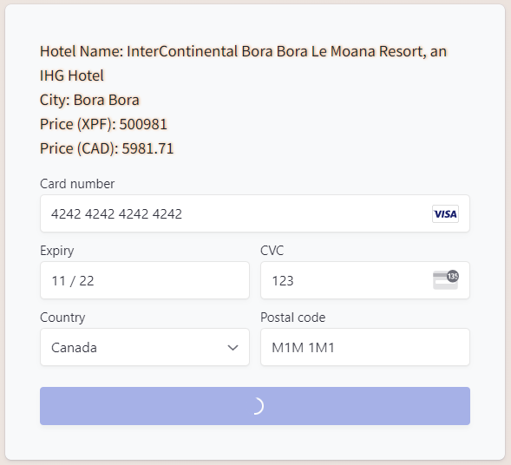
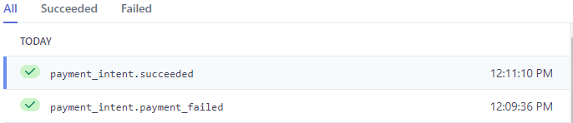
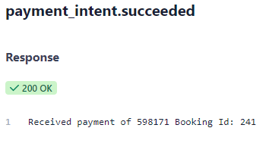
Stripe Payment Implementation (Successful Payment)

Slide 24
Back-end Solution

Slide 25
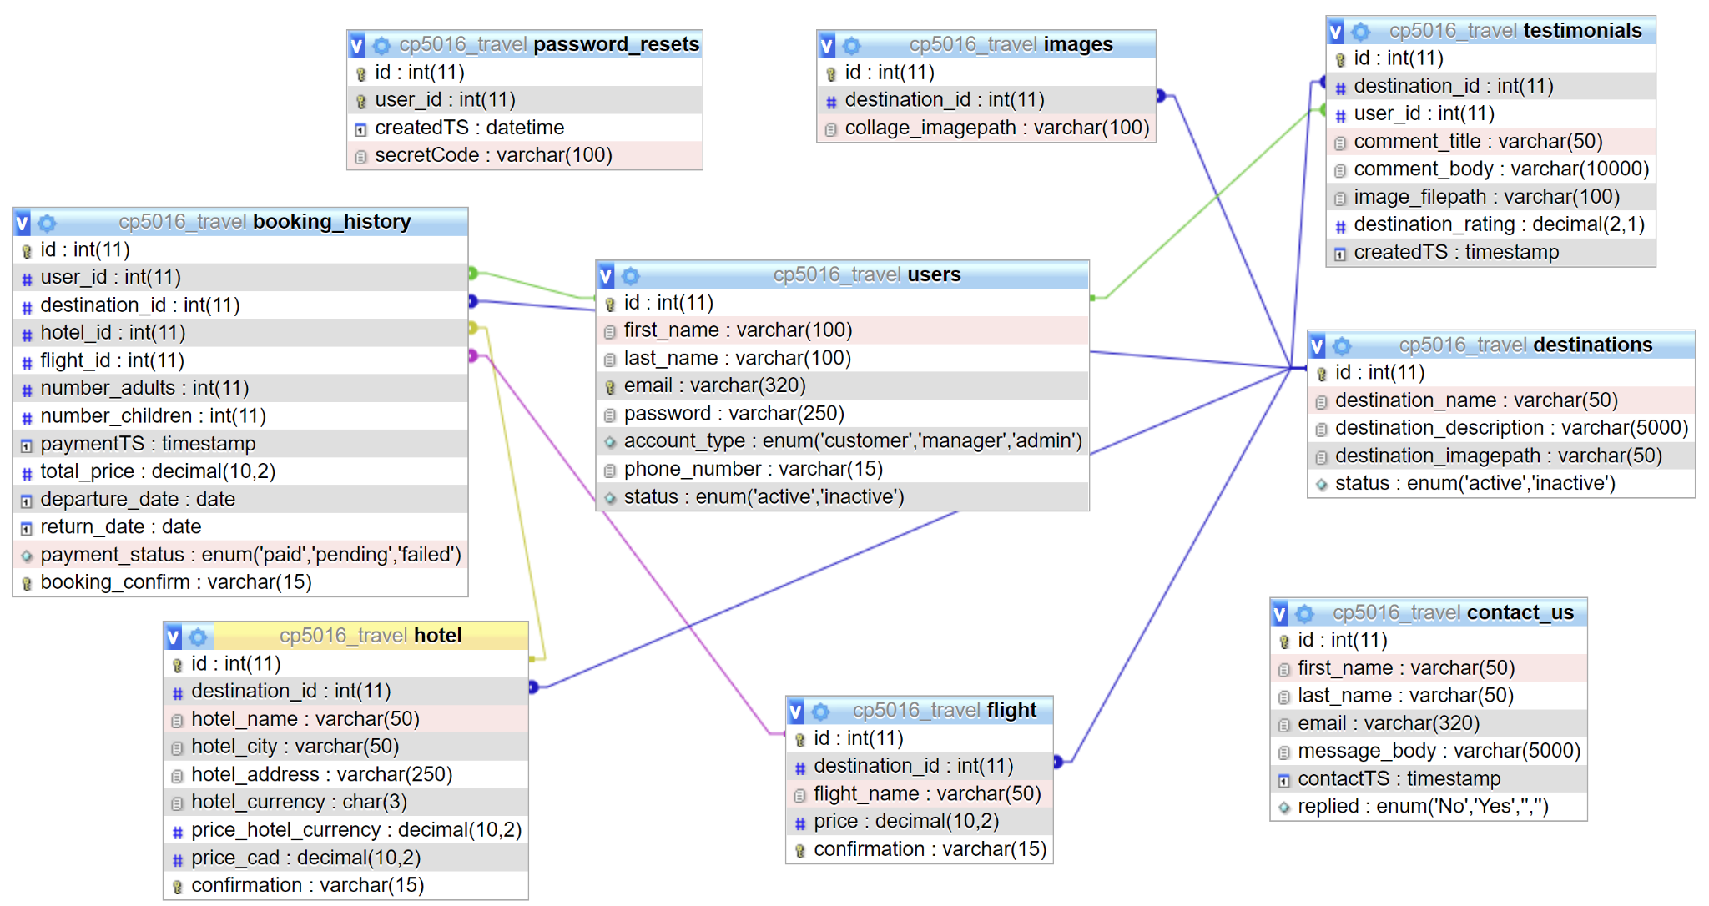
Database Structure

Slide 26
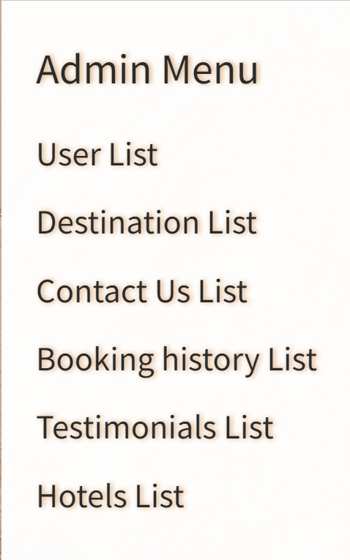
Back-end Solution - Ileana
Overview of Backend Functionality
Allows site administrator to control user accounts
Allows control of site destinations
Allows view and/or edit of database tables

Slide 27
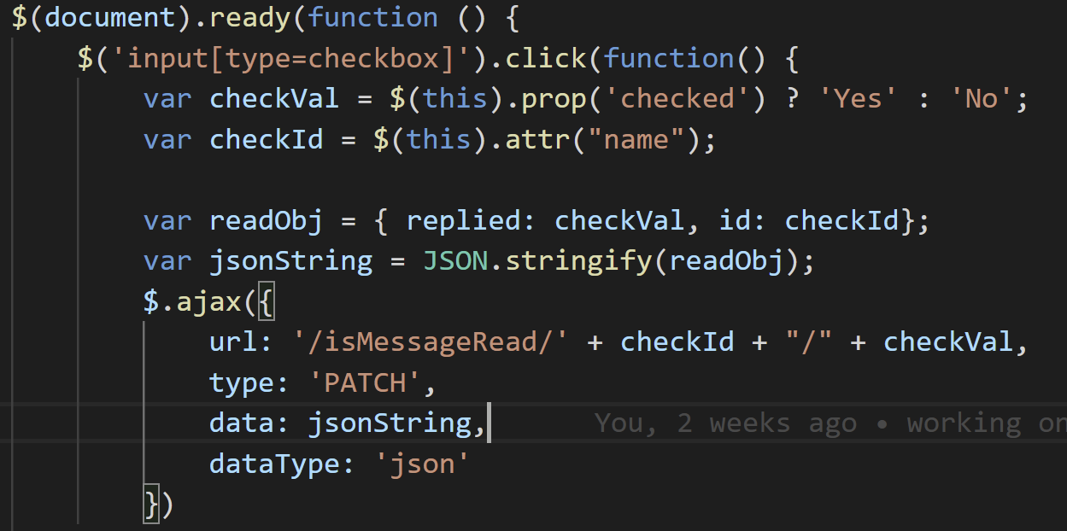
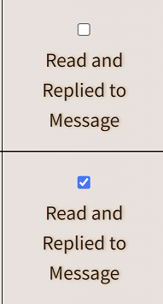
A Challenge and Solution?
Challenge: Allow site administrator or manager to see if a user who contacted us has received a reply
Solution: Use jQuery and Ajax to dynamically update DB if message has been read

Slide 28
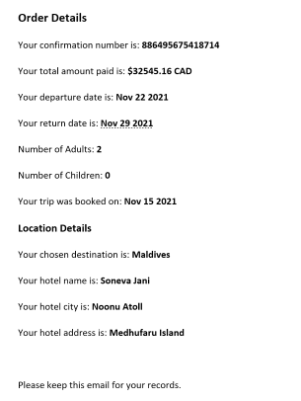
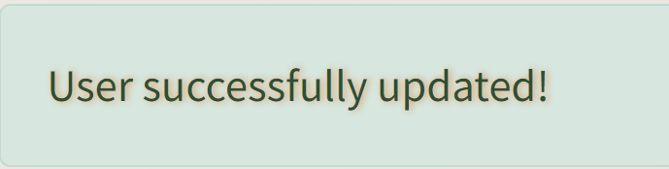
New Implementations
Implemented Flash messages with Bootstrap alerts to show successful operation
Used email template in PHP to send user an email to reset password
Send out email confirmation email to user on successful booking.

Slide 29
Summary
A user can successfully register with the site and acquire all needed information to successfully book a hotel stay.
An admin can view tables of relevant data and edit site content.

Slide 30
Future work
Big things to add
Flight api
Calendar
Little things to add
Manager reports
Add pagination
Email templates from third party vendor
Add realtime api call to destination add so manager can’t add incompatible destination

Slide 31

Thanks!
Team SIT
Stefan, Ileana and Tyler

